Slide 1

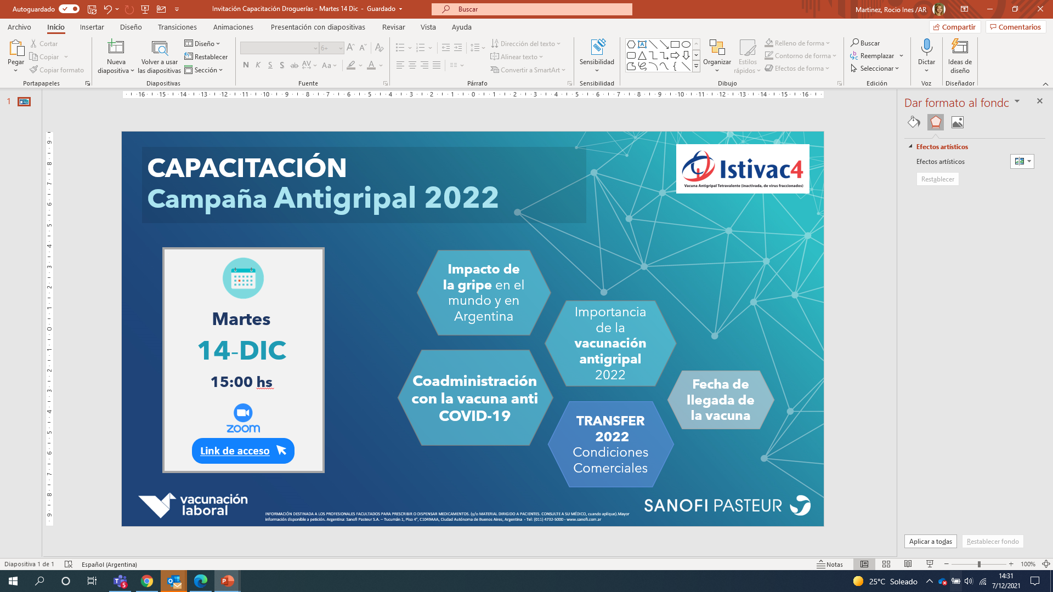
INSCRIBITE ACÁ

